Slide 1
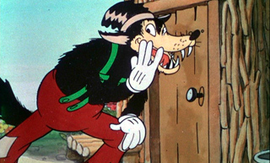
Fairy Tales, Beasts, & Big Bad Wolves

Slide 2
Brainstorming
Working on your own, compile a list of all the fairy-tale ‘monsters’ you can think of.
Working with a partner or small group, observe and speculate:
What do these monsters have in common?
What is their function in the story?
What do these monsters tell you about the genre of the fairy tale?

Slide 3
Questions We Will Ask
What are “fairy tales” and “folk tales”?
Why do we read or listen to (or write or tell) them?
How do we study them?

Slide 4
What is the definition of a “fairy tale”?
Merriam-Webster:
“A simple children’s story involving fantastic forces and beings (as fairies, wizards, and goblins)”
“A made-up story usually designed to mislead”

Slide 5
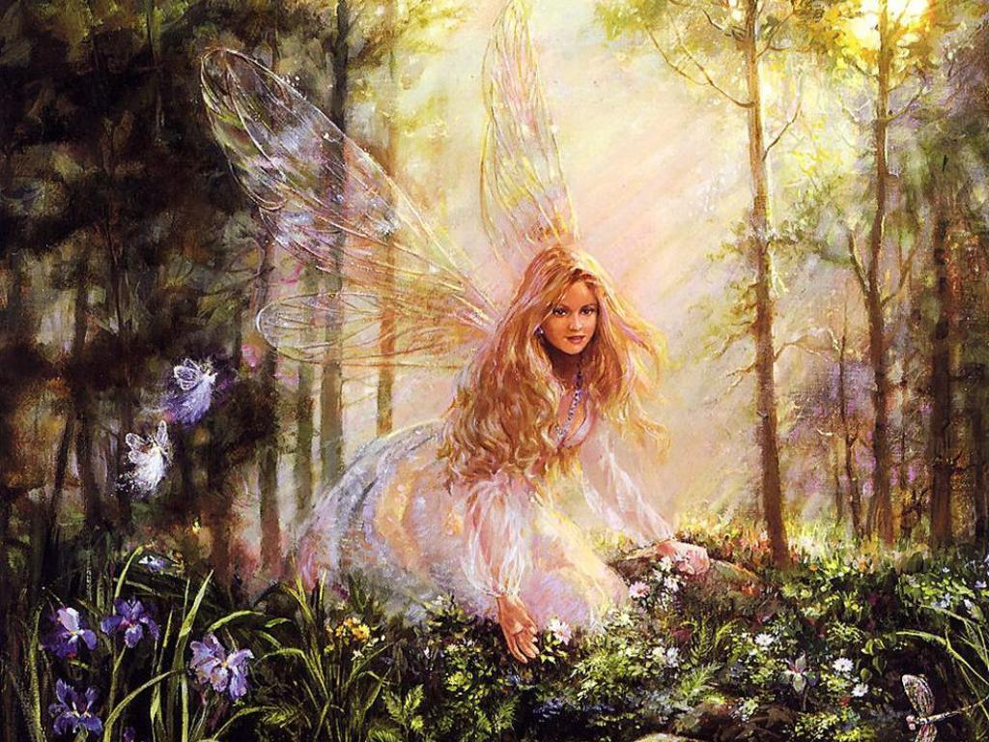
Why are they called “fairy” tales?
Sometimes, they have fairies…

Slide 6
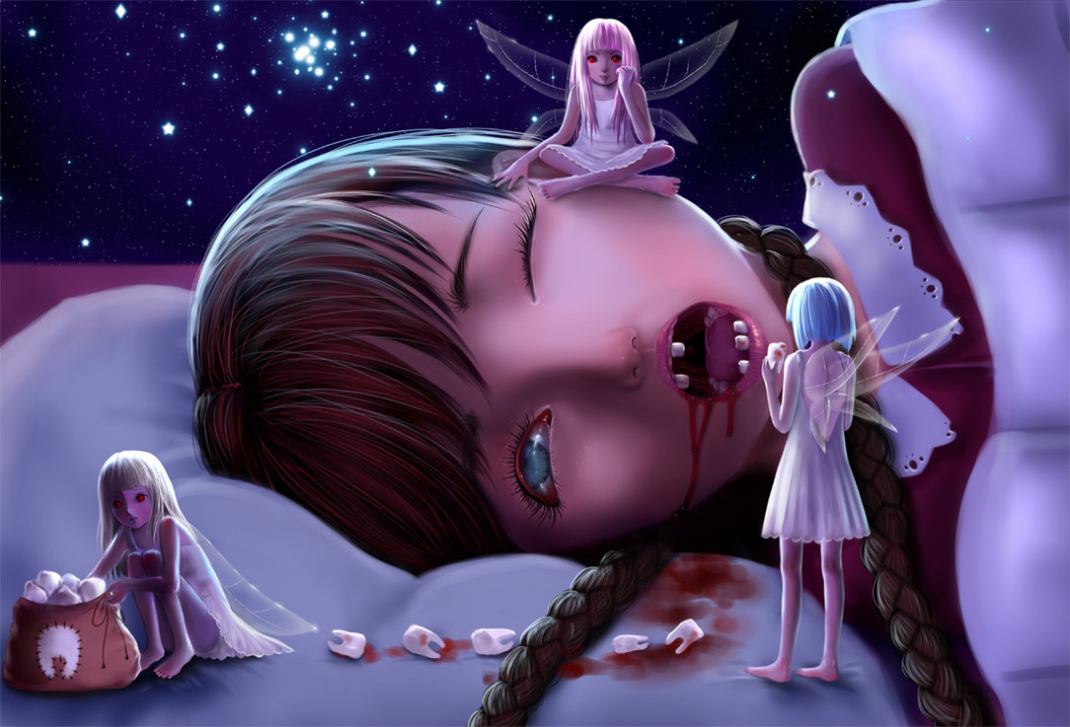
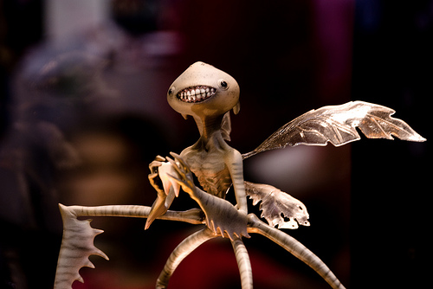
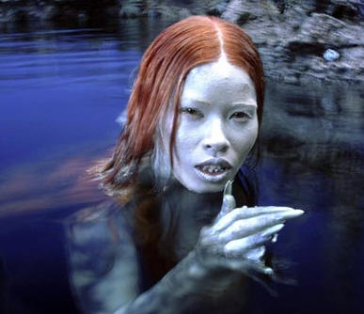
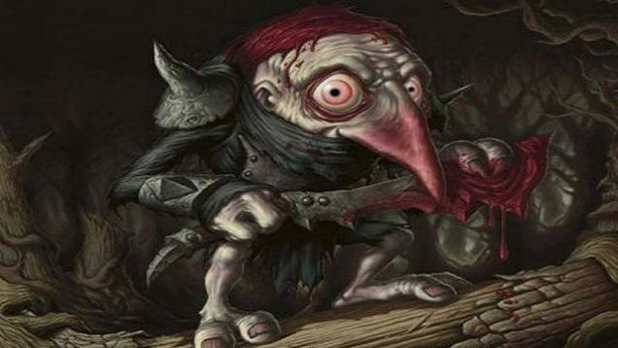
… however, not all fairies are created equal!

Slide 7
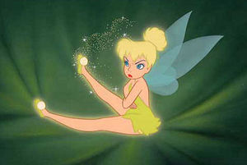
The term “fairy” could refer to:
Small humanoids
Winged beings
Gnomes
Trolls
Goblins
Demons
Sprites
Spirits
Angels
Witches
Enchanted (adj.)
Magical (adj.)
Notes:
E.g., “witch” in Hansel and Gretel, Rapunzel is originally a “fairy”

Slide 8
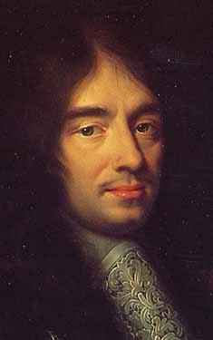
History and Form of Fairy Tale
Charles Perrault (1628-1703)
Histoires ou contes du temps passé (1697)
[Tales and Stories of the Past with Morals]
Best known tales include:
Little Red Riding Hood
Cinderella
Puss in Boots
The Sleeping Beauty
Bluebeard

Slide 9
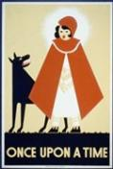
History and Form of Fairy Tale
Charles Perrault (1628-1703)
Histoires ou contes du temps passé (1697)
[Tales and Stories of the Past with Morals]
Included explicit morals at the end of each tale
E.g., at the end of “Little Red Riding Hood”:
Little girls, this seems to say
Never stop upon your way.
Never trust a stranger-friend;
No one knows where it will end.

Slide 10
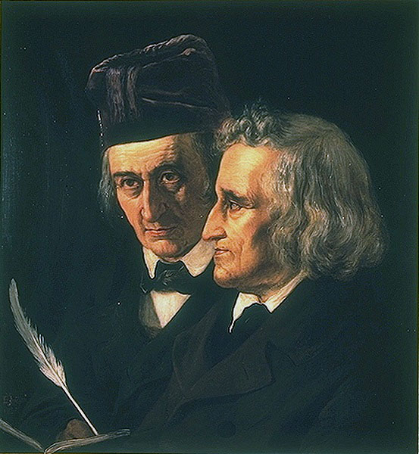
The “Brothers Grimm”
Jacob Grimm (1785-1863)
Wilhelm Grimm (1786-1859)
Kinder- und Hausmärchen (1812)
[Children’s and Household Tales]
Best known tales include:
Little Red Riding Hood
Cinderella
Puss in Boots
The Sleeping Beauty
Bluebeard
…look familiar?

Slide 11
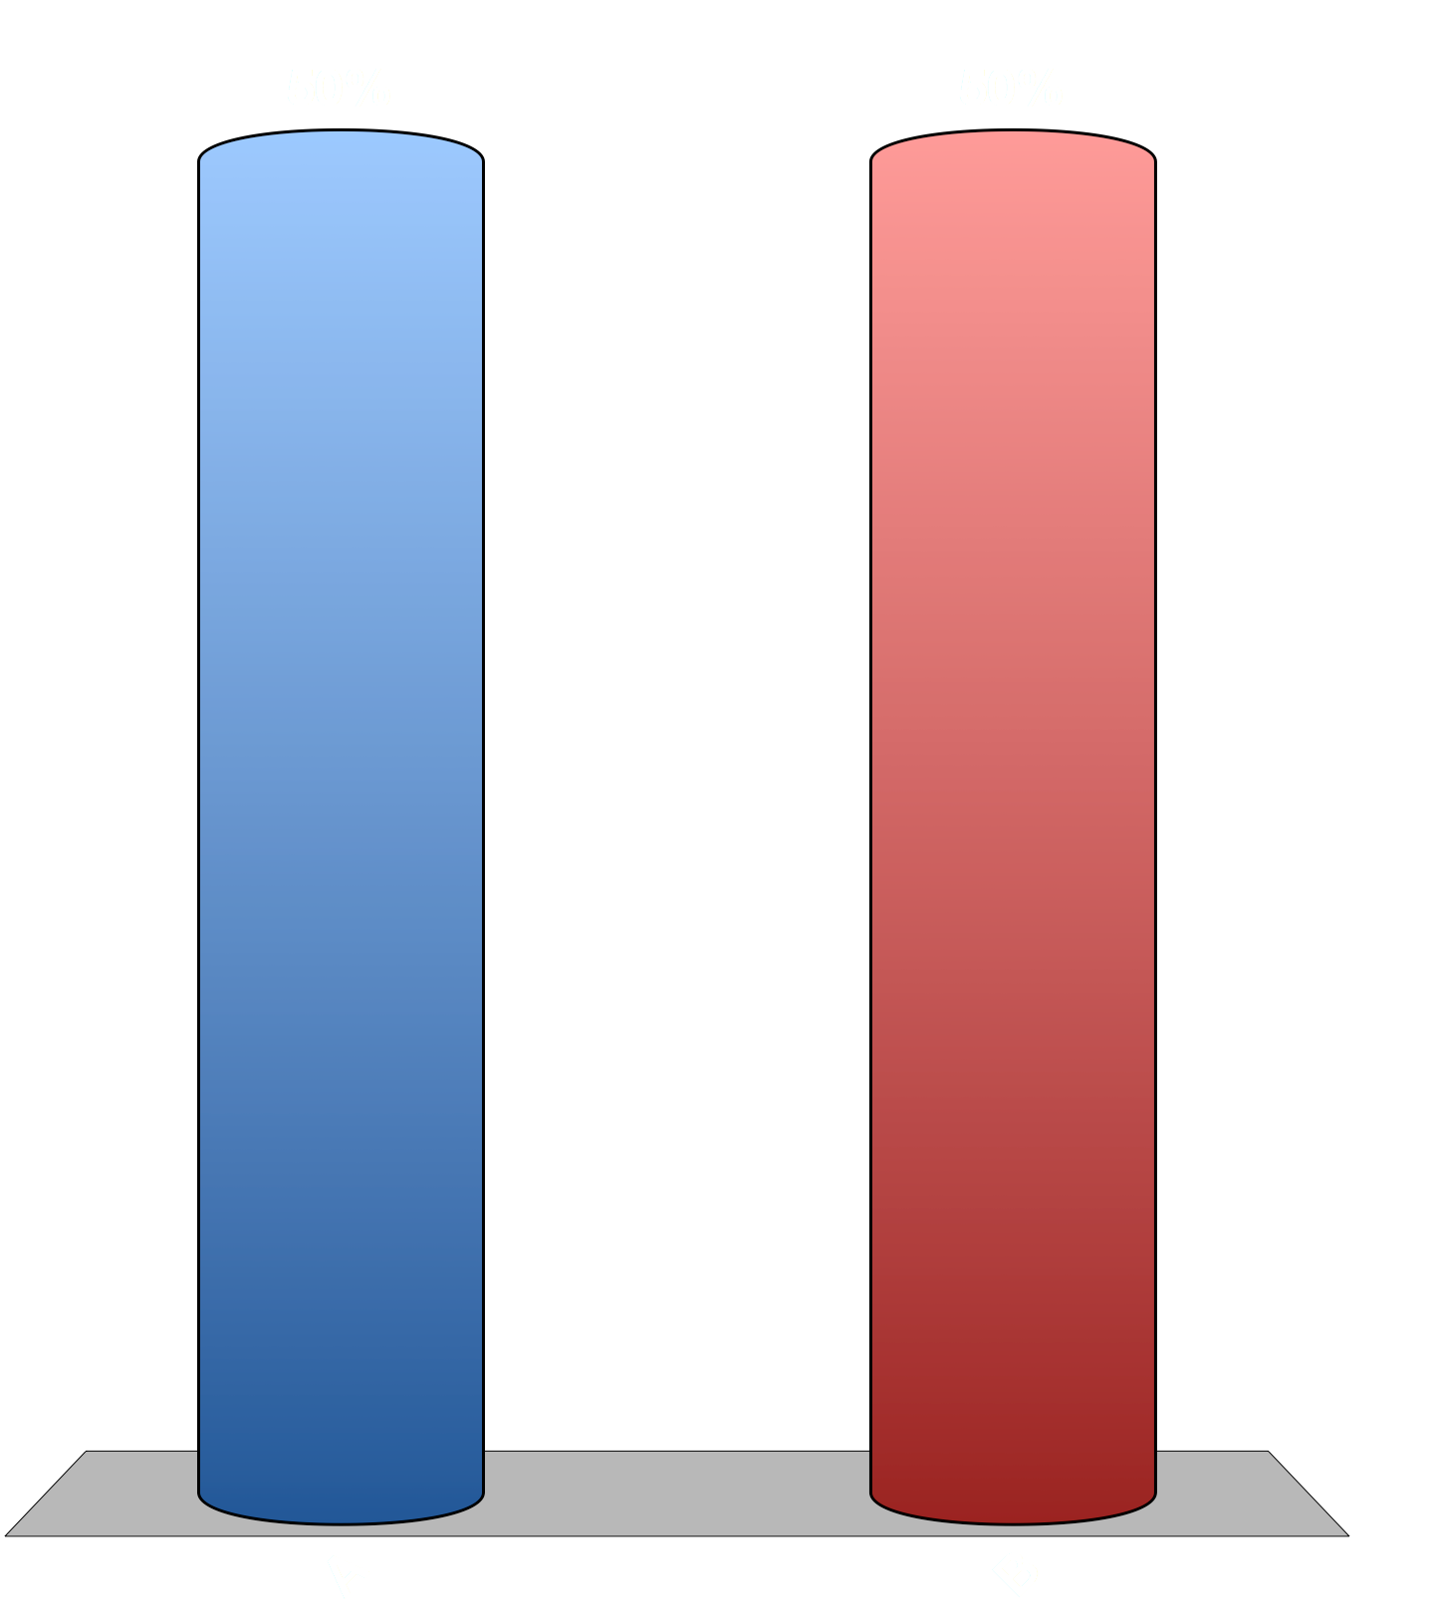
The “Brothers Grimm” wrote most of the fairy tales in their well-known collection.
True
False

Slide 12
Myth 1: The Brothers Grimm wrote Fairy Tales
They collected stories from many sources
Revised, expanded, and rewrote their collection over several decades (1812-64)
Increasing emphasis on Christian values
Made more ‘literary,’ stylized: more description, symmetrical forms
‘Adult’ and violent material cut or softened
Viewed fairy tales as literature of the people (Volk)
*Thus, they both are and are not “by” the Grimms

Slide 13
Fairy tales were intended primarily for children and young adults.
True
False

Slide 14
Myth 2: Fairy tales are for children
Note this title: Children’s and Household Tales
Households often included children of different ages, parents, grandparents, laborers, cousins, etc.
Fairy tales also functioned as adult entertainment: in parlors, salons, & fields—not in the nursery
Hence prevalence of rape, incest, pregnancy, murder, and mutilation in fairy tales

Slide 15

How do fairy tales typically end?
“…happily ever after”
With a marriage
With a death
With an explicit moral

Slide 16
Myth 3: Fairy tales always have happy endings.
See how Perrault’s “Little Red Riding Hood” ends:
Little Red Riding Hood took off her clothes and got into bed. She was greatly amazed to see how her grandmother looked in her nightclothes, and said to her, "Grandmother, what big arms you have!"
"All the better to hug you with, my dear."
"Grandmother, what big legs you have!"
"All the better to run with, my child."
"Grandmother, what big ears you have!"
"All the better to hear with, my child."
"Grandmother, what big eyes you have!"
"All the better to see with, my child."
"Grandmother, what big teeth you have got!"
"All the better to eat you up with."
And, saying these words, this wicked wolf fell upon Little Red Riding Hood, and ate her all up.

Slide 17
Myth 4: Fairy tales always have an explicit moral.
Sometimes they do, as in Perrault’s version:
Moral:
Little girls, this seems to say, Never stop upon your way. Never trust a stranger-friend; No one knows how it will end. As you’re pretty, so be wise; Wolves may lurk in every guise. Handsome they may be, and kind, Gay, or charming never mind! Now, as then, ‘tis simple truth— Sweetest tongue has sharpest tooth!

Slide 18
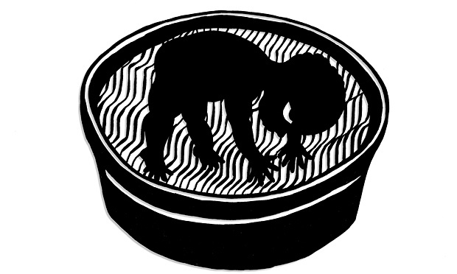
Myth 4: Fairy tales always have an explicit moral.
Sometimes they don’t, as in this other tale collected by the Brothers Grimm:
“How Some Children Played at Slaughtering”

Slide 19
Signal Question
If there is a ‘monster’ in “Little Red Cap,” it’s obviously the wolf: what does he represent? What other possible symbols do you find in the tale? What might they represent, or how might they contribute to the message or moral of the story?
Write/reflect for about five minutes.

Slide 20
“Little Red Cap” (Red Riding Hood)
Potential “symbols”:
The girl herself
Wolf
Granny
Forest
Path
Mother
Huntsman
Home

Slide 21
“The male… is [represented as] all-important, split into two opposite forms: the dangerous seducer who, if given in to, turns into the destroyer of the good grandmother and the girl; and the hunter, the responsible, strong, and rescuing father figure. It is as if LRC is trying to understand the contradictory nature of the male by experiencing all aspects of his personality: the selfish, asocial, violent, potentially destructive tenancies of the id (the wolf); and the unselfish, social, thoughtful, and protective propensities of the ego (the hunter). ”
—Bruno Bettelheim, The Uses of Enchantment

Slide 22
Signal Question
The two endings of Perrault’s and the Grimms’ versions of ‘Little Red Cap/Riding Hood’ are very different. How does the ending change the meaning of the tale? Does either one suggest a different interpretation of the Wolf and what he symbolizes?

